Slide 1
















TRIPFINDER WEBSITE
Supervised By:
RAVEESH SAMKARIA
Submitted By:
Pulkit vashisht 2210992594 ( G-14 )

Slide 2
ABSTRACT
Trip Finder is a comprehensive travel website template designed to facilitate seamless exploration and booking of diverse travel experiences. The template offers a user-friendly interface with strategically arranged sections including a dynamic banner area showcasing contact details and navigation options. The search box empowers users to filter tours based on various criteria, while the tour type area presents a range of enticing travel options. Additionally, the deal area highlights special offers and discounts, enhancing user engagement. The news area keeps visitors informed about the latest travel trends and events. With a responsive design, TripFinder ensures accessibility across devices, while the footer provides essential company information and support links. Through its intuitive layout and rich features, Trip Finder serves as an ideal platform for travelers to discover, plan, and book their next adventure.

Slide 3
INTRODUCTION
Welcome to TripFinder, your go-to destination for unlocking unforgettable travel experiences worldwide. With a user-friendly interface and curated selection of tours, activities, and destinations, TripFinder simplifies the journey from dreaming to exploring. Whether you're seeking relaxation on a sun-kissed beach or adventure in a bustling metropolis, TripFinder is your trusted companion for crafting your next adventure. Join us as we embark on a journey of discovery and wanderlust together.

Slide 4
OBJECTIVE
TripFinder aims to simplify travel planning by providing a user-friendly platform for discovering and booking diverse travel experiences. Our goals include curating compelling options, enhancing user experience, promoting accessibility, and fostering trust and reliability. Ultimately, we strive to inspire and empower travelers to explore the world with confidence and ease
Overall, TripFinder aims to inspire and empower travelers to explore the world, create unforgettable memories, and embark on journeys of discovery and self-discovery.

Slide 5
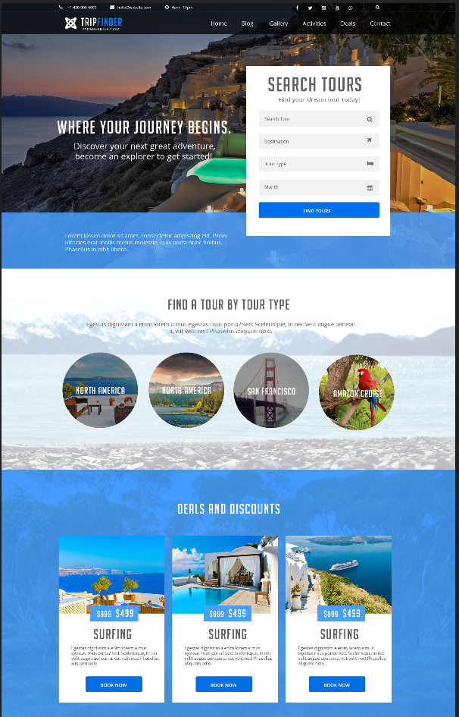
PROBLEM STATEMENT
We were provided with the unique templates to design them in same way .
Below are the screenshot of template provided to me .

Slide 6
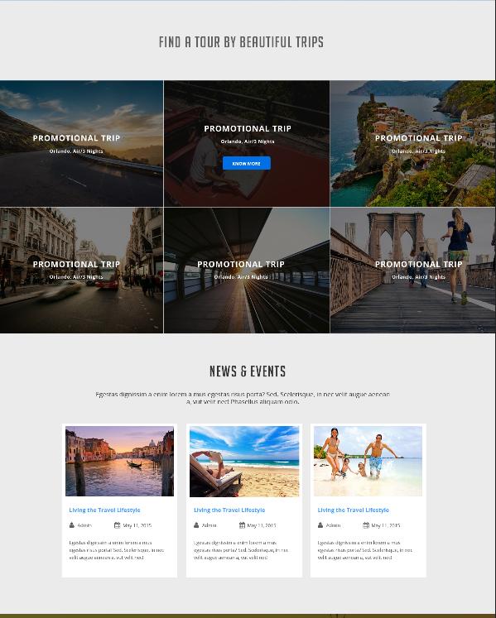
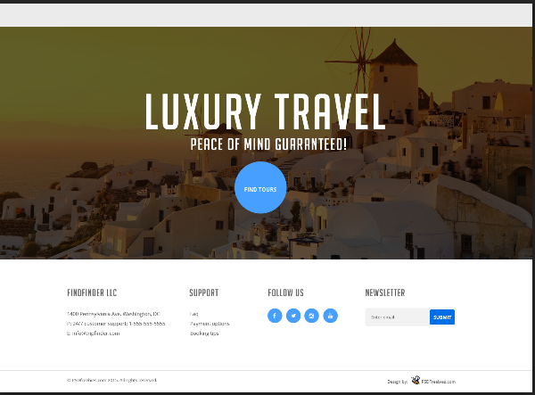

Slide 7
REQUIREMENTS
Software Requirements :
HTML: HTML provides the fundamental structure for web pages, consisting of elements enclosed in tags, which define the content and layout.
HTML documents should adhere to standards and undergo validation to ensure proper syntax, structure, and compatibility across different web browsers and device
CSS: CSS is used to define the presentation and layout of HTML elements on a web page, including aspects such as color, font, size, spacing, and positioning. CSS models elements on a web page as rectangular boxes, comprising content, padding, border, and margin. Developers can manipulate these box properties to control layout and spacing.

Slide 8
JAVASCRIPT: JavaScript is primarily used for client-side scripting in web development, allowing developers to create dynamic and interactive web pages by manipulating the Document Object Model (DOM) based on user interactions.
JavaScript enables developers to access and modify HTML elements and attributes dynamically, facilitating tasks such as content updates, element creation, removal, and styling based on user actions or events.

Slide 9
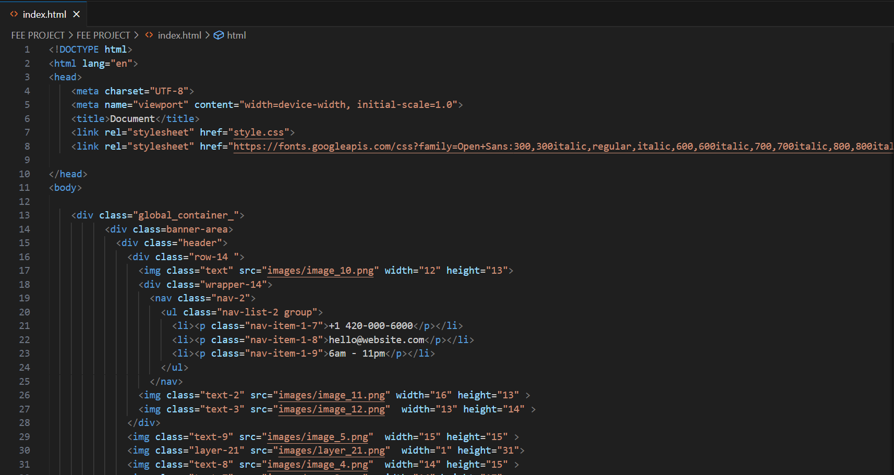
METHODOLOGY
HTML CODE :

Slide 10
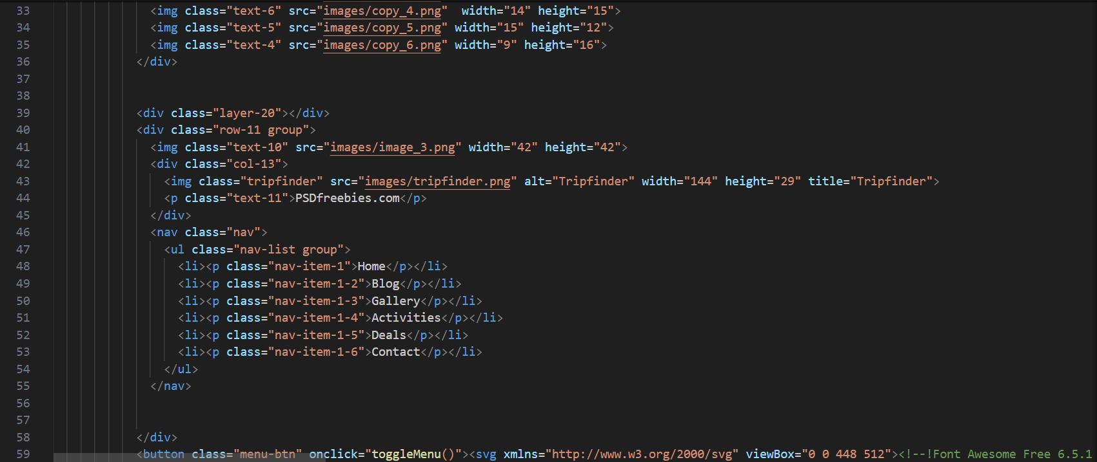
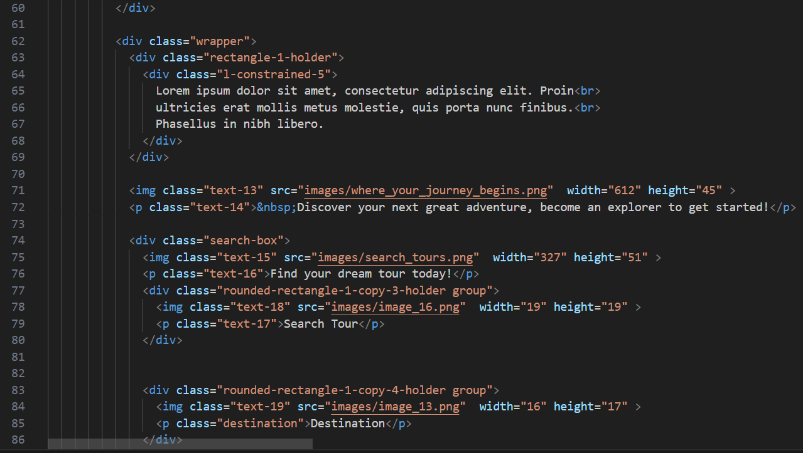

Slide 11
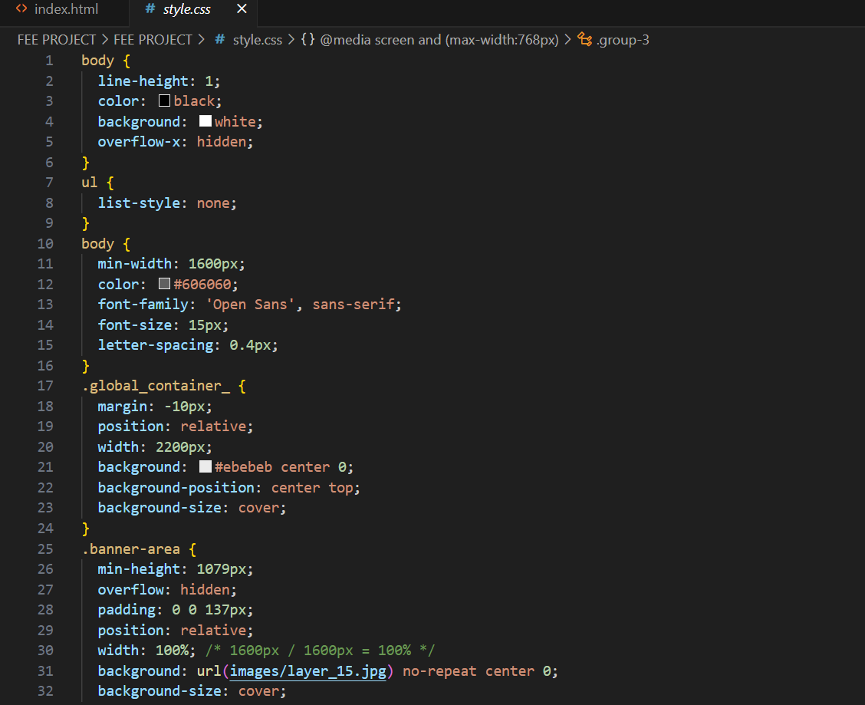
CSS CODE :

Slide 12
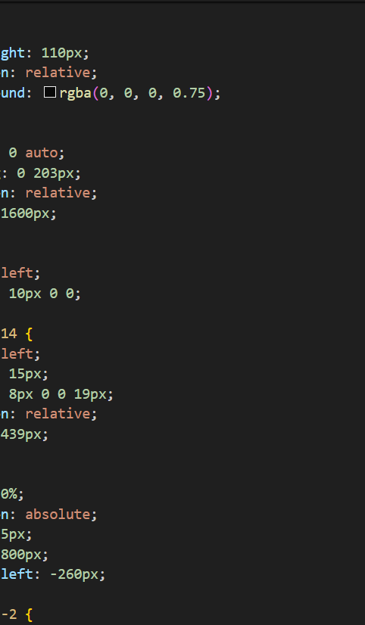
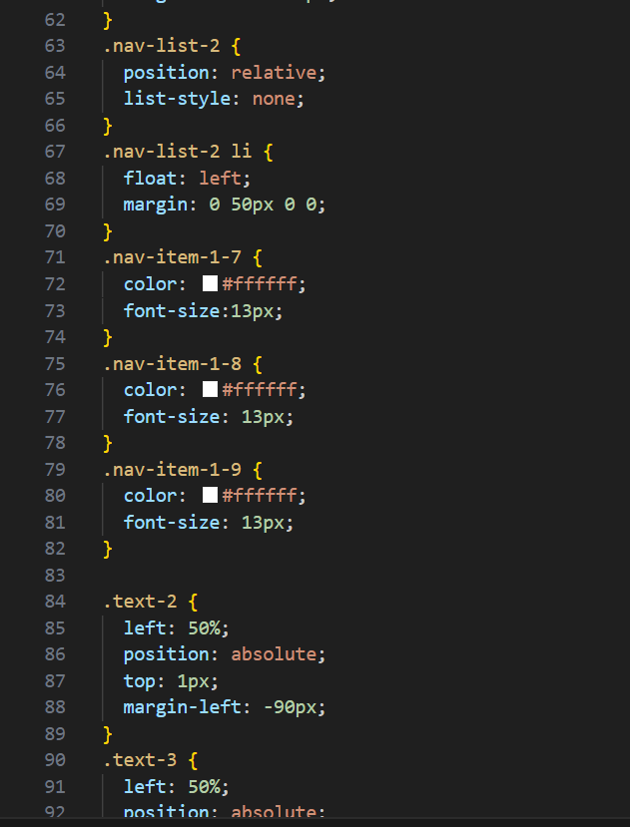

Slide 13
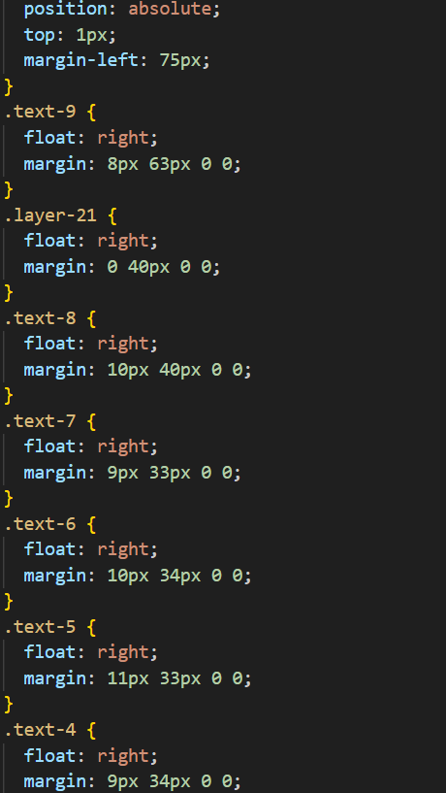

Slide 14
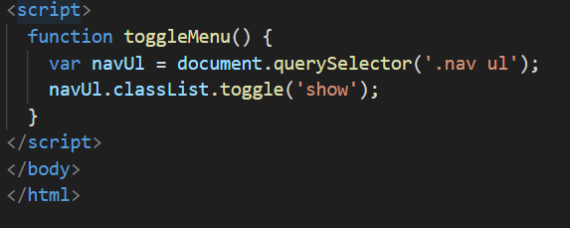
JAVA SCRIPT CODE :

Slide 15
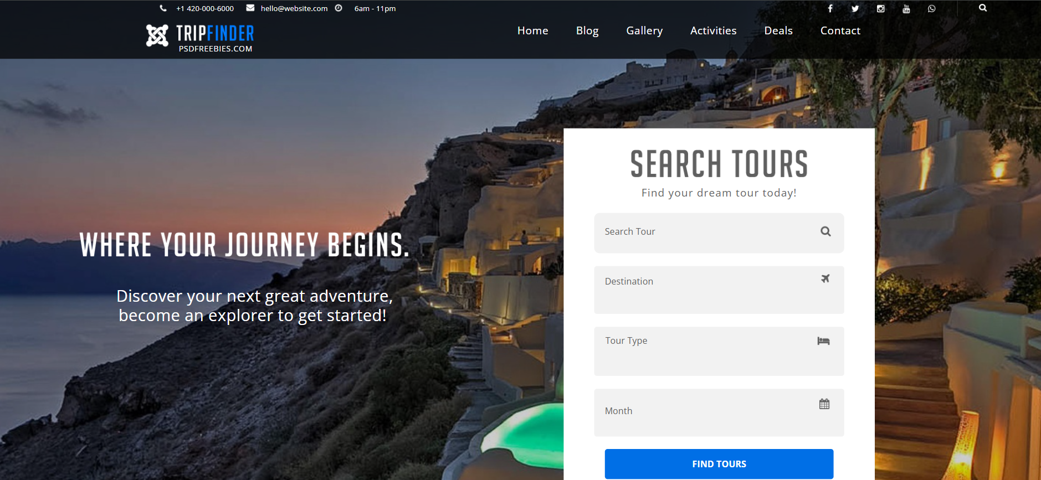
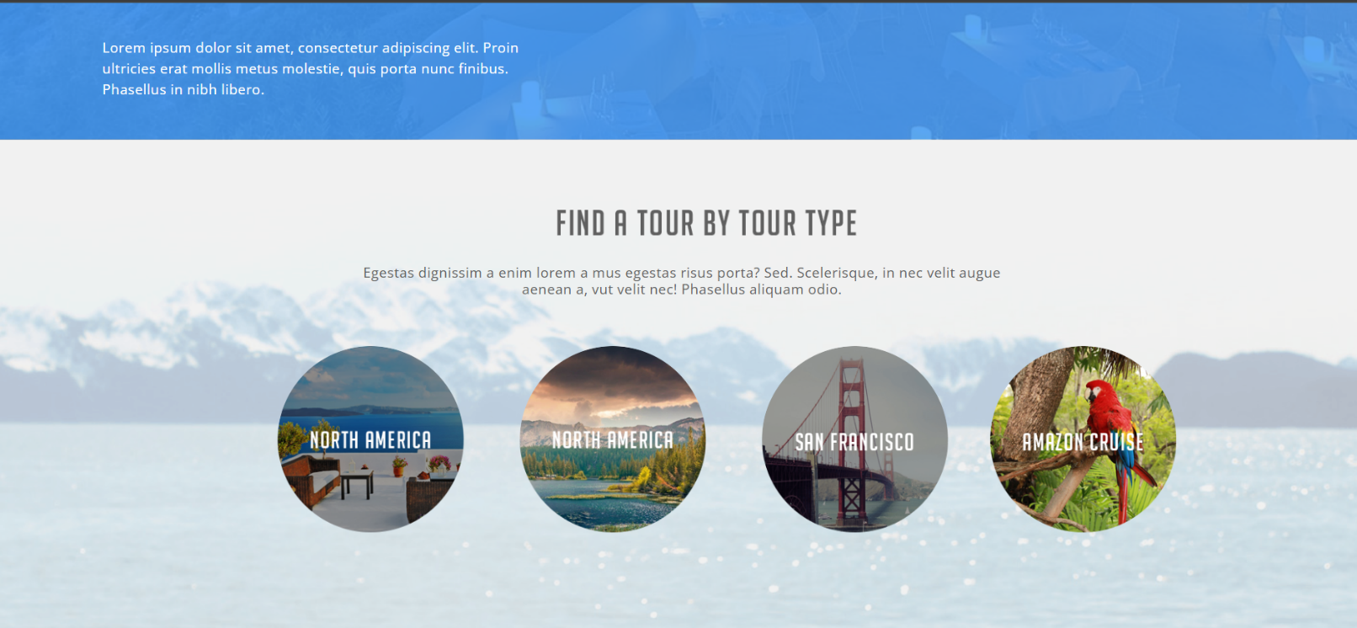
RESULT

Slide 16
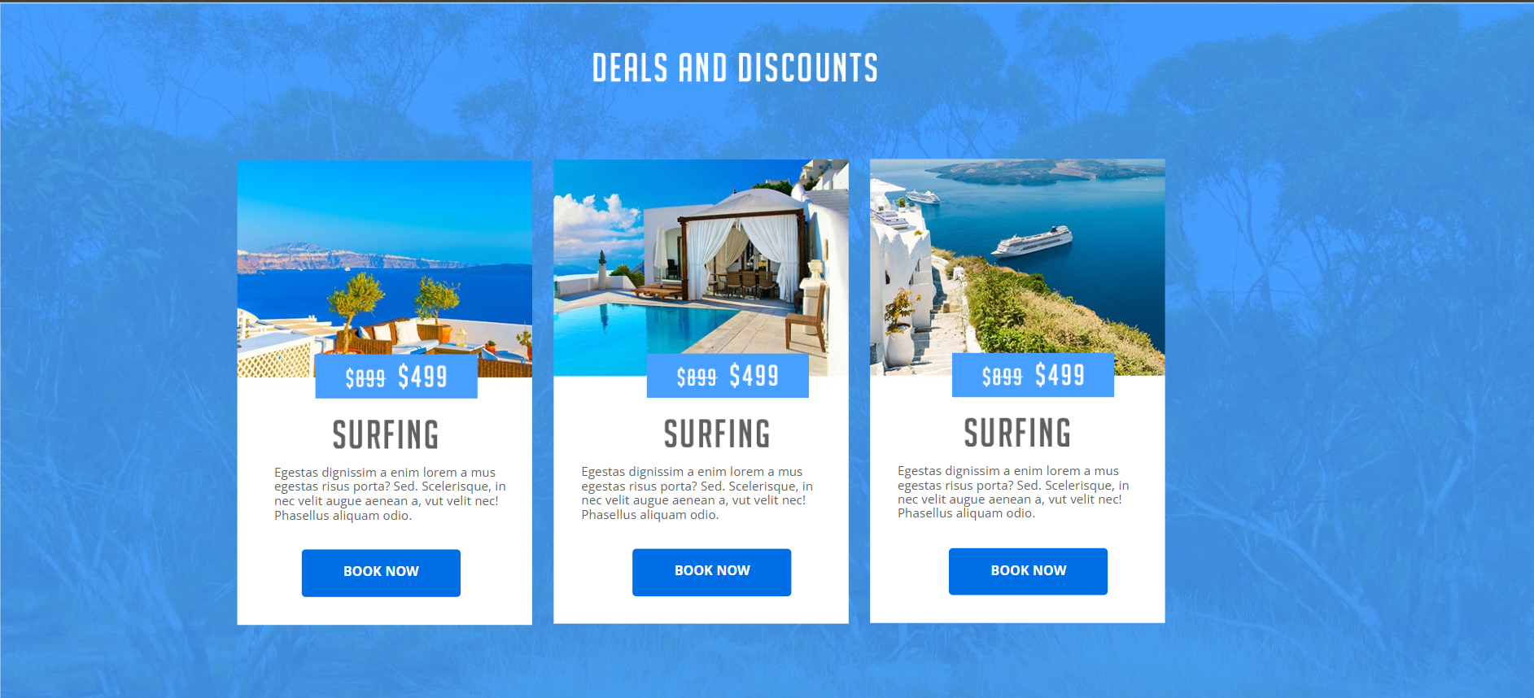
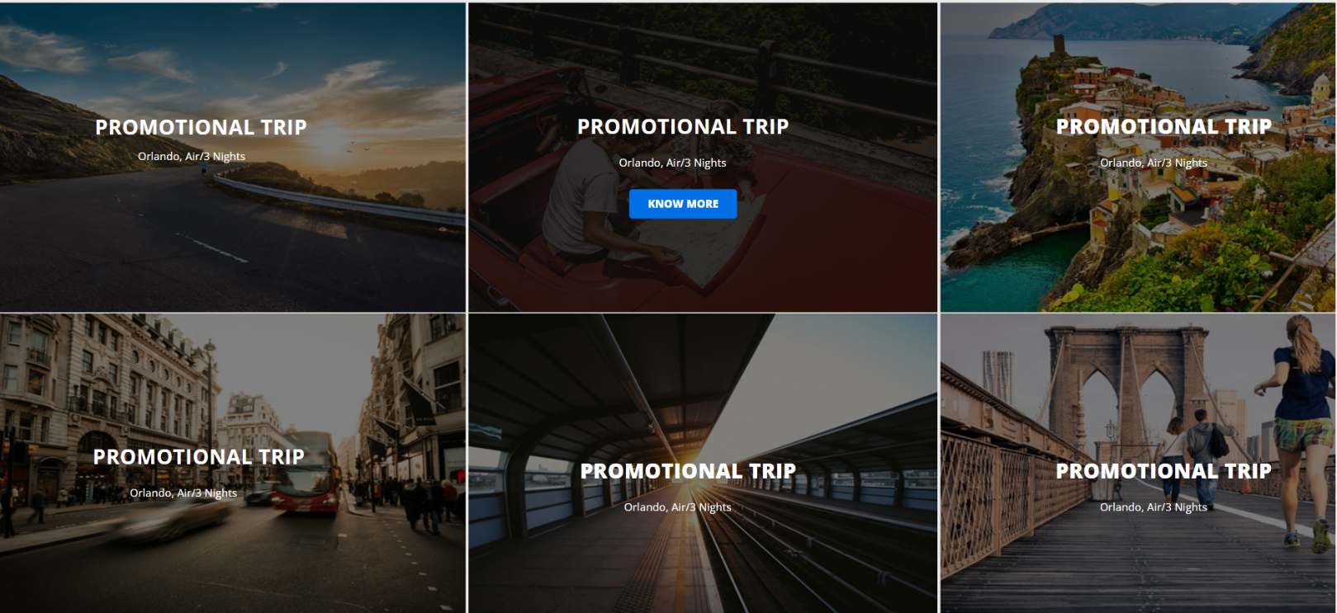

Slide 17
